Slide 1

CheckPoint 2 Presentation
By Nic Cutrona & Kris Nair

Slide 2
Twenty-Eight Card Game Rules
•4-Player Game, Player 1 and 3 are on teams, and Player 2 and 4 are on teams
•This game only uses the Jack (3), the 9 (2), the Ace (1), the 10 (1), and the King, 8, Queen, and 7 (0) of each suit. Each player gets a hand of 8 random cards.
•The maximum point total is 28 points

Slide 3
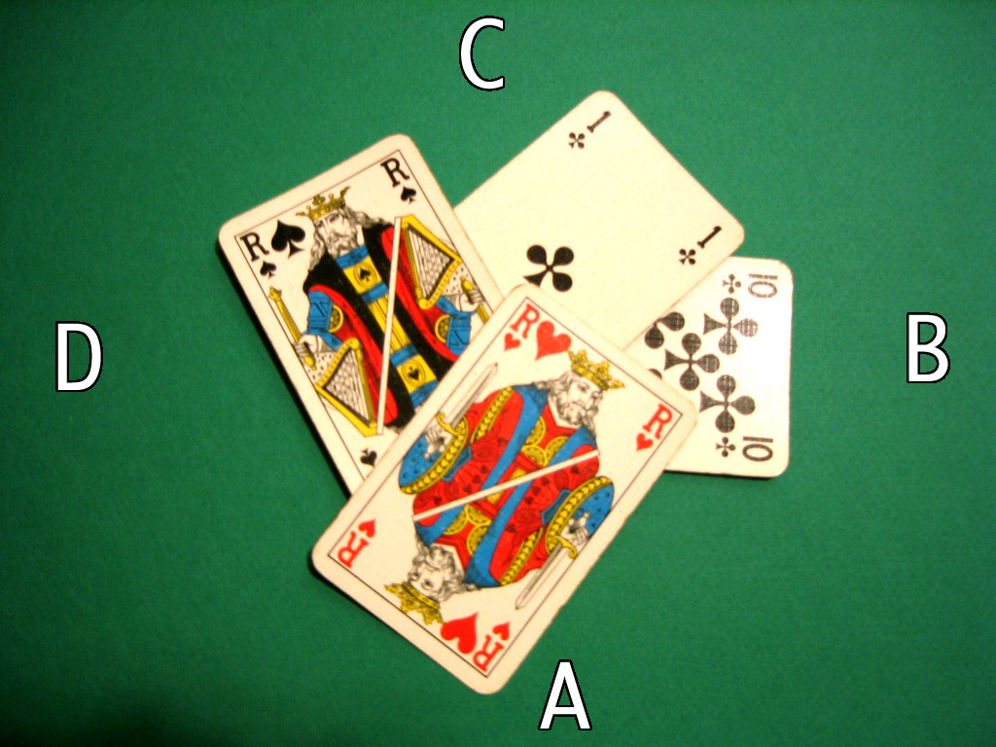
Twenty-Eight Card Game Rules
•The first player (chosen at random) sets down the card first. All subsequent players have to put down a card of the same suit as the first. The player with the highest rank card collects all of the points for that round.

Slide 4
Twenty-Eight Card Game Rules
•This pattern continues for 8 rounds and the team with the highest point total wins.
• Every three rounds there will be a mystery spot on the board that rewards the placing player all of the points for that round.

Slide 5
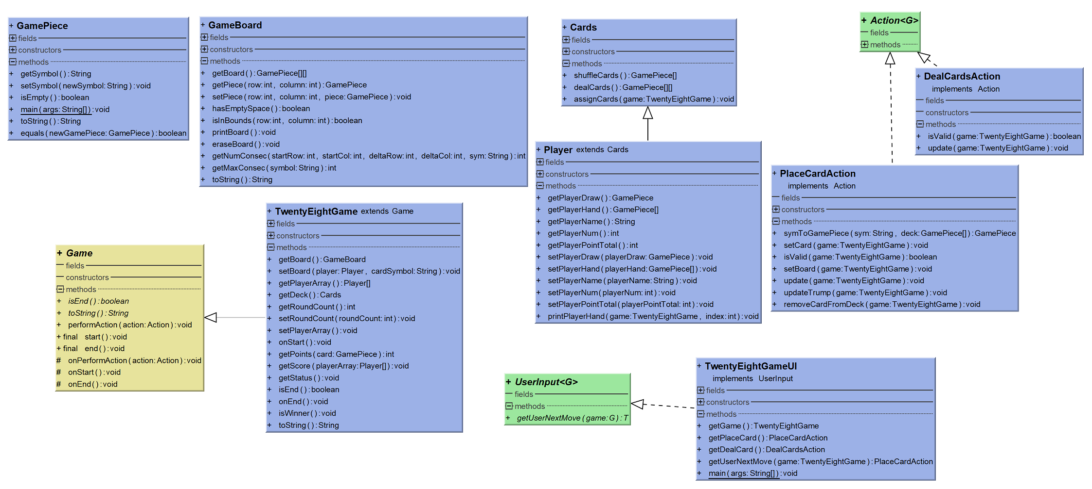
UPDATED UML
Too many fields to display.

Slide 6
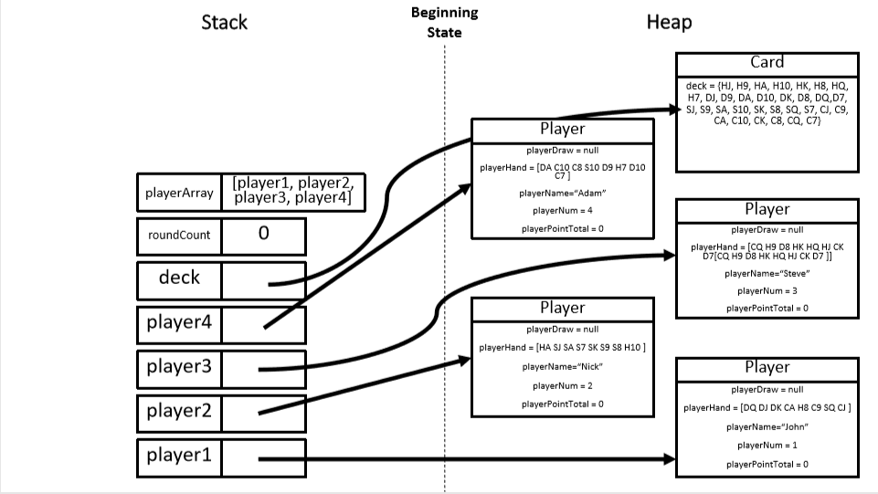

Slide 7
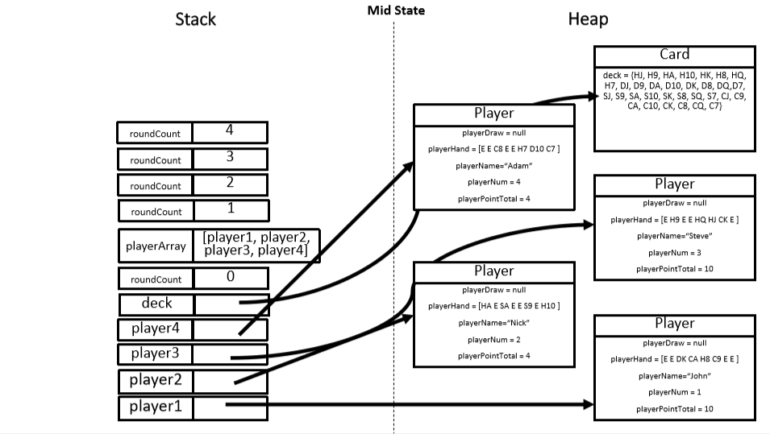

Slide 8
